Slide 1
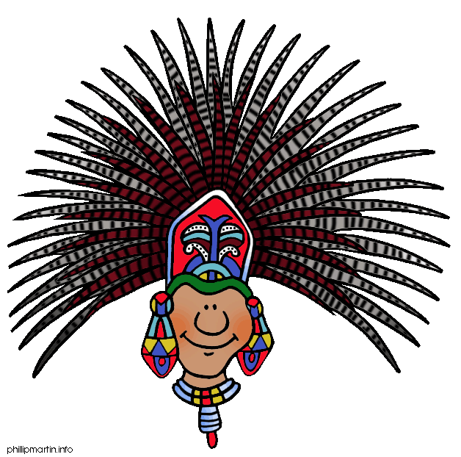
Understanding Mayan religion.

Slide 2
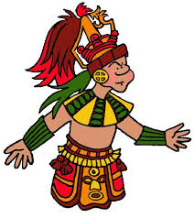
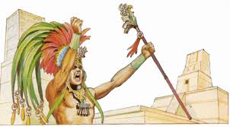
The lives of the ancient Maya centred around their religion and gods of nature.
The Mayas believed in many gods and goddesses.
They believed their priests could talk to the gods. This gave the priests incredible power.

Slide 3
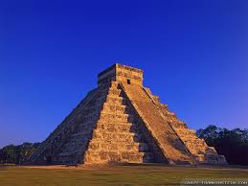
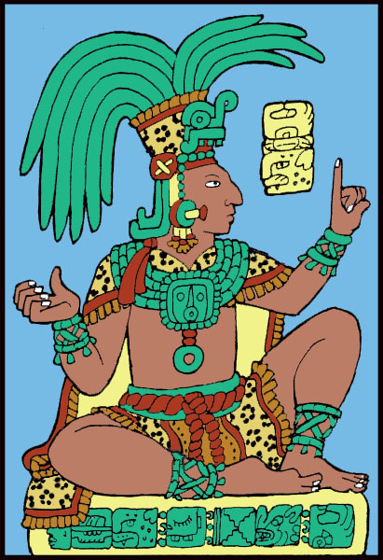
The priests were the most powerful people in the Maya
civilization.
Priests decided nearly everything in the Maya daily life. They decided when to plant, when people could marry, and whom to sacrifice!

Slide 4
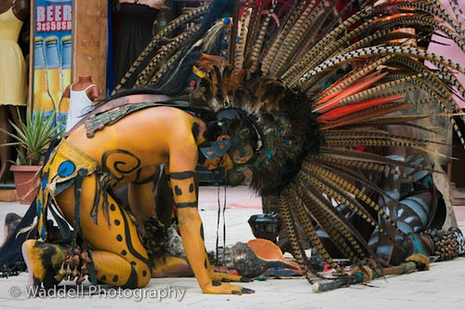
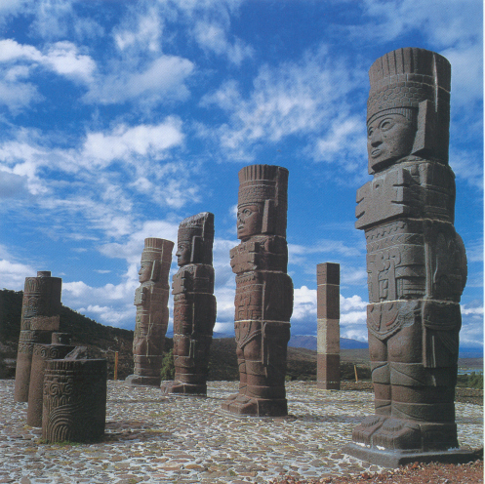
Mayan Gods…
The Mayas worshipped the gods of nature every day.

Slide 5
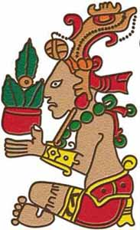
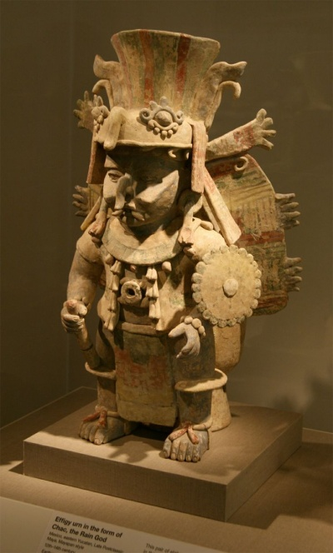
Some of their gods included the God of Rain, the God of Maize (corn), and of course, the God of Sun.
Without the help of these important gods, there would be no crops and everyone would starve.

Slide 6
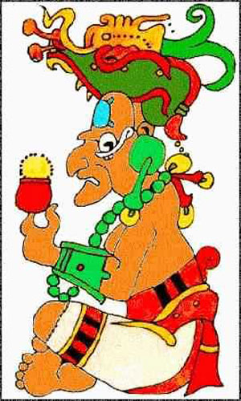
Each god had both a good and evil side.
The most
important deity was the supreme god Itzamná, the creator god, the god of
the fire and god of the earth.

Slide 7
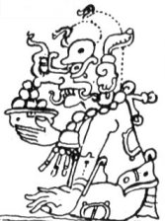
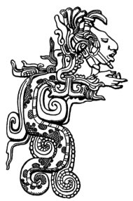
Another important Maya god was Kukulcán,
the Feathered Serpent, who appears on many temples.
Also important was Chac, a
hooked-nose god of rain and lightning.

Slide 8
MAYAN FACT!
All of the men, but none of the women, used mirrors.
In the ancient Maya world, looking into a mirror was an act of courage.
The Maya believed that monsters from the Place of Awe could reach through the mirror, and yank you into the Otherworld.

Slide 9
The afterlife…
The Mayas believed in an afterlife.
Nobles were buried in tombs while commoners buried their dead inside their homes, under the floor.
That way, they could live with their ancestors and keep their ancestors easily informed about their daily life.

Slide 10
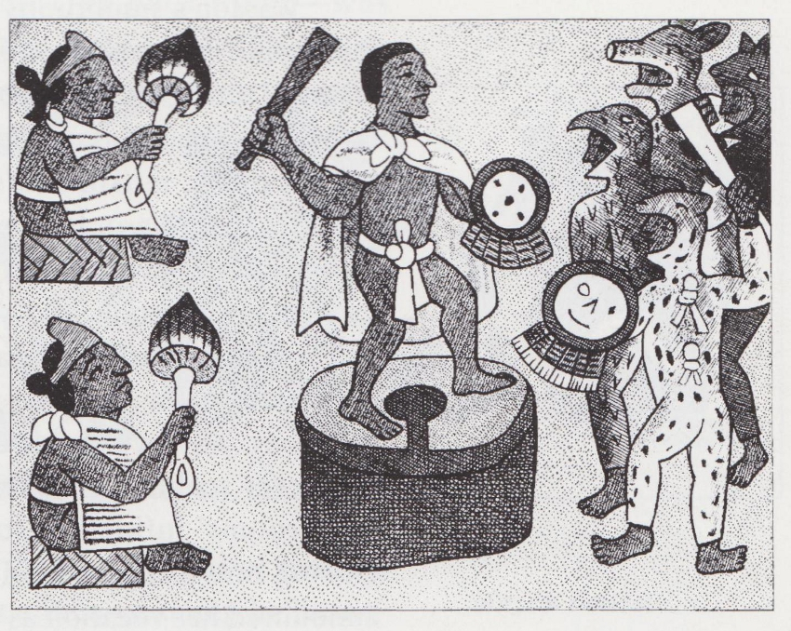
The Maya world was composed of 3 layers - the Heavens, the Earth and the Underworld, sometimes called the Otherworld or the Place of Awe.
The Mayas conducted many ceremonies to keep the demons, creatures and gods in the Underworld, where they belonged.

Slide 11
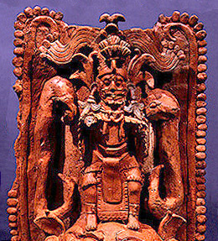
The Mayan view of the afterlife consisted primarily of a dangerous voyage of the soul through the underworld, which was populated by sinister gods and represented by the jaguar, symbol of night.

