Slide 1
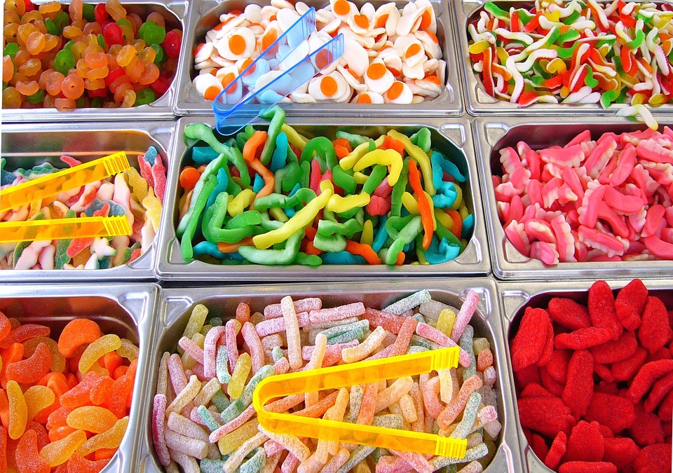
FRACTIONS YEAR 6
Q1
You have 48 sweets. You can choose between having
a) 4/6 or b) 5/8 of the total amount of sweets.
Would you choose a or b so that you had the most
or least amount of sweets?
Make sure you explain your answer.

Slide 2
4/6 of 48 sweets
5/8 of 48 sweets

Slide 3
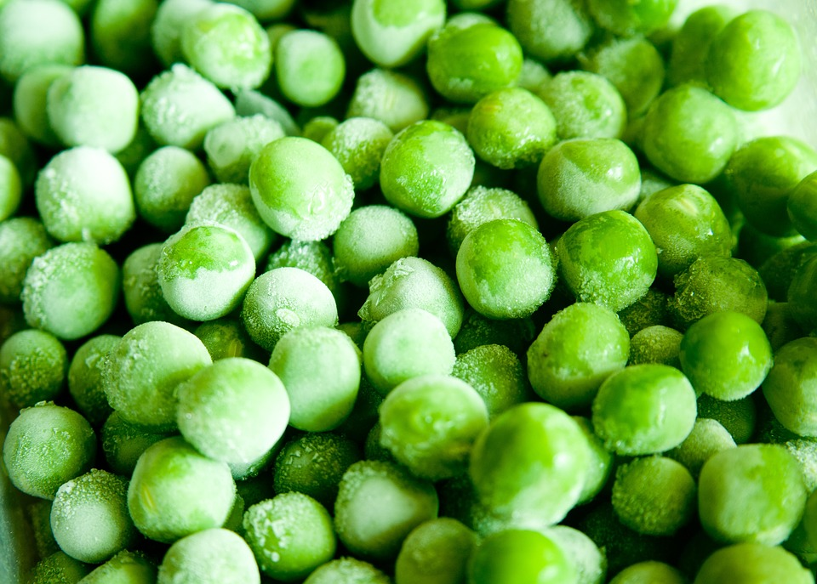
Q2
You are cooking frozen peas. There are 63 frozen peas
in a bag. You can use either 3/7 or 4/9 of the total
amount of peas.
Which fraction of the frozen peas will you choose
so that you have the most amount of peas to go with
your Sunday dinner? Explain your answer.

Slide 4
3/7 of 63 frozen peas
4/9 of 63 frozen peas

Slide 5
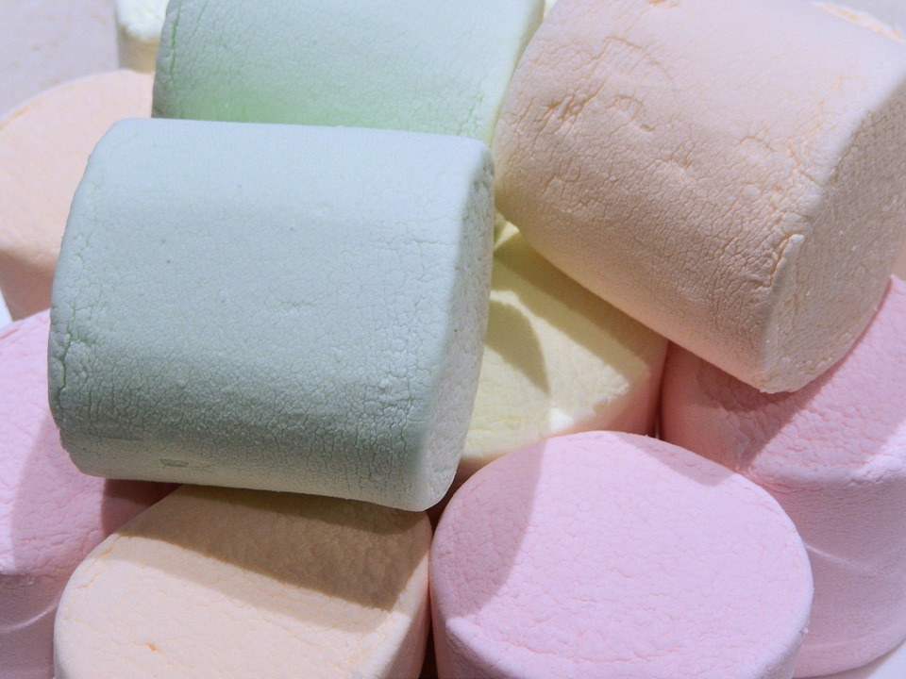
Q3
You have got 56 marshmallows to share at a party.
But you have to give some to your brother.
You can either keep 3/7 or ½ of the marshmallows to
share at your party.
Explain which fraction you would choose so that you
had the greatest amount to share at your party.

Slide 7
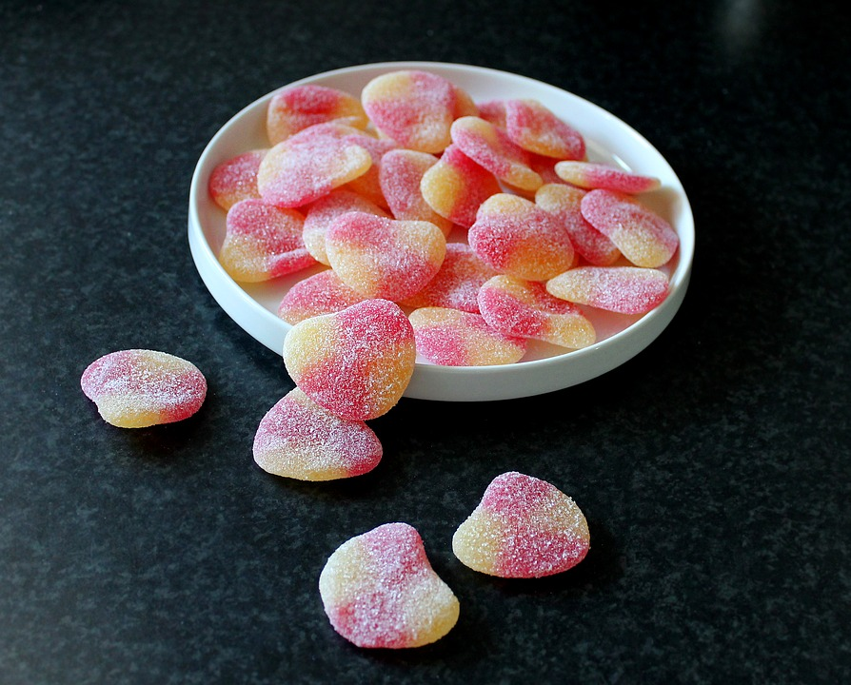
Q4
For charity, you are organising a sweet stall at playtime. You have 70 sweets to sell. You can either sell 4/5 or 5/7 of this amount.
You are allowed to share the rest of the sweets with your class.
Which fraction of the sweets would you sell on your stall so that you had the greatest amount of sweets to sell for charity?

Slide 9
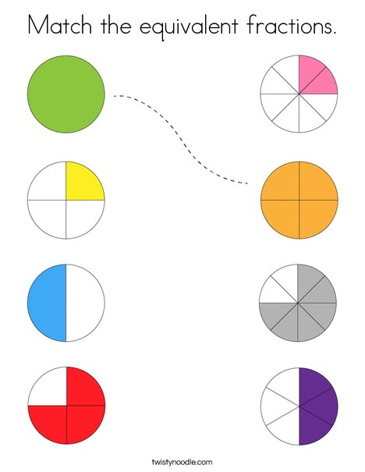
Explain why each is equivalent to it’s partner.

Slide 10
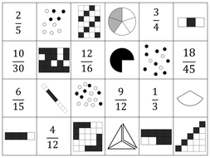
Match the equivalent
fractions presented in
different ways.

Slide 11
We would like you to
Spend 15 minutes
on Times Tables
Rockstars

Slide 12
Watch the link for
A TTrockstars throwback.
Ashfield Junior School
you are amazing!
https://www.youtube.com/watch?v=HWr2pWb7HEo

