Slide 1
PARENTS’ GUIDE TO SAFEGUARDING
2026

Slide 2
OUR AIMS IN THESE PRESENTATIONS:
To increase your knowledge of the safeguarding risks to children
To understand the different types of abuse
To be able to recognise signs of abuse
To know your responsibilities as a parent
To know what to do if you are worried/concerned

Slide 3
WHAT IS SAFEGUARDING?
Safeguarding is the action that is taken to promote the welfare of children and protect them from harm.
Safeguarding means:
● protecting children from abuse and maltreatment
● preventing harm to children’s health or development
● ensuring children grow up with the provision of safe and effective care
● taking action to enable all children and young people to have the best outcomes
● child protection is part of the safeguarding process. It focuses on protecting individual children identified as suffering or likely to suffer significant harm. This includes child protection procedures which detail how to respond to concerns about a child.

Slide 4
Safeguarding at AJS
At Ashfield Junior School safeguarding is of paramount importance and underpins all that we do. Ensuring our children feel safe and are safe is deeply rooted in our ethos and practice as a school. We expect all our staff, visitors, parents and the wider community to share this commitment.
All our staff are trained to safeguard our children. Crucially they know how to look out for, and spot signs of, children who are at risk of being harmed or are being harmed.
We have specific policies and procedures that all staff follow to ensure our children are safe from harm. The following policies can be found on the school website:
Keeping Children Safe in Education
Child Protection
Prevent

Slide 5

SAFEGUARDING
We ensure all our children have at least one member of staff in school whom they can talk to if they are worried.
Whilst how to keep safe is woven throughout our whole curriculum, our children are specifically taught key knowledge and skills within their PSHE and Safeguarding lessons.
The PSHE and Safeguarding curriculum has been designed to instil into our children how to manage risks, how to stay safe and what to do if they believe they are in danger.
We are committed to providing a safe and secure environment where children and adults feel confident about sharing any concerns which they may have about their safety or the well-being of others.

Slide 6
SAFEGUARDING
We will now look at a selection of the key safeguarding risks to children.
All of the types of abuse and criminal activities outlined in this presentation do happen and we need to be educated on these risks so that we can protect our children from harm.
None of the information shared is intended to scaremonger but instead has the purpose of informing parents of potential dangers, signs to look out for and how they can support their child to stay safe.
If parents are concerned at any point about their child or another child, they should always seek help.
At Ashfield, we have several safeguarding leads who can help you if you need it.
Please see the list of staff at the end of this presentation, or on the school website, and either email, phone or contact us in person.

Slide 7
WHAT ARE THE DIFFERENT FORMS OF ABUSE?
There are 4 main types of abuse:
Physical: Includes hitting, shaking, drowning, poisoning and any other physical harm towards a child. This also includes parental mental health issues.
Emotional: Includes persistent torment including telling children they are useless, unloved, and inadequate etc, not allowing children to express their views and making fun of them or deliberately silencing them, over-protection and limiting exploration, preventing them from joining in normal social activity and mental health.
Sexual: Includes forcing or enticing children to take part in sexual activity, assault by penetration (rape), non-penetration, kissing, touching outside of clothing, encouraging children to behave in sexually inappropriate ways, and grooming a child in preparation for abuse and mental health issues.
Neglect: Neglect is the persistent failure to meet a child’s basic physical and/or psychological needs, likely to result in the serious impairment of the child’s health or development. This includes substance misuse in pregnancy, not providing adequate basic needs i.e. food, shelter etc, and preventing physical harm.

Slide 8


Slide 9

ONLINE ABUSE
The NSPCC have defined online abuse as ‘any type of abuse that happens on the internet.’
Any child who uses the internet can be at risk of online abuse. It can happen on any device connected to the web such as computers, tablets, mobile phones and game consoles.
The abuse can be through text messages, emails, online chats, video calls, online gaming and live streaming accounts via social media.
Social media platforms to look out for are:
TIK TOK, House Party, Instagram, Snapchat and WhatsApp

Slide 10

ONLINE ABUSE: WHAT PARENTS NEED TO KNOW
Children can be at risk of online abuse by someone they know or a stranger.
Online abuse could be in addition to other offline abuse such as bullying or grooming.
Sexting and the law: Sending grossly offensive, indecent, obscene or menacing communications is an offence.
By possessing, and/or distributing indecent images of a person under the age of 18 years of age on to someone else is breaking the law under the Sexual offences Act 2003.

Slide 11
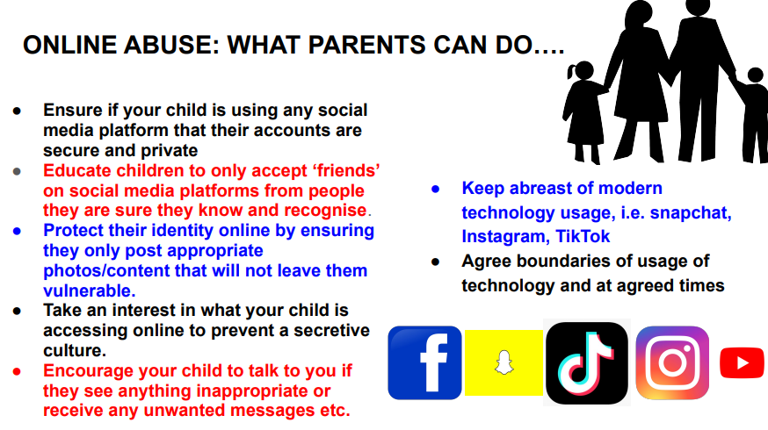

Slide 12


Slide 13

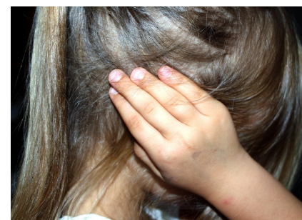
RECOGNISING DOMESTIC ABUSE
Domestic abuse describes any violence or abuse that is used by someone to control or obtain power over their partner. It can include physical, sexual, psychological, verbal, emotional and financial abuse. If you alter your behaviour because you are frightened of how your partner will react, you are being abused.
Freephone 24-Hour National Domestic Abuse Helpline:
0808 2000 247

Slide 14
Controlling & Coercive behaviour
Controlling behaviour :
A range of acts designed to make a person dependant by isolating them from sources of support, depriving them of the means they need for independence and regulating their everyday behaviour.
Freephone 24-Hour National Domestic Abuse Helpline:
0808 2000 247
Coercive behaviour:
An act or a pattern of assault, threats, humiliation and intimidation or other abuse that is used to harm, punish or frighten their victim. This can include rape, ‘honour-based’ violence, Female Genital Mutilation (FGM) and forced marriage.

Slide 15
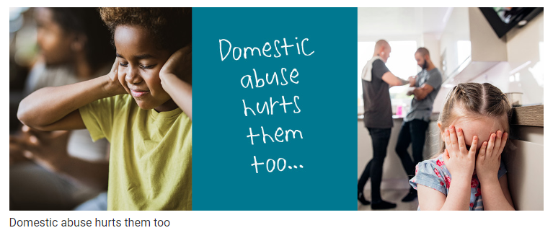
AM I A VICTIM OF DOMESTIC VIOLENCE?
Is your partner excessively jealous?
Is your partner stopping you from seeing your family and friends?
Is your partner telling you what to wear, how to behave and what to say?
Does your partner control your money?
Does your partner monitor your movements?
Does your partner use anger to intimidate you to comply with their commands?
If you have said ‘yes’ to any of these questions, you are in a domestic abuse relationship.
There are many forms of help to support you and your children.
School is one of them.

Slide 16
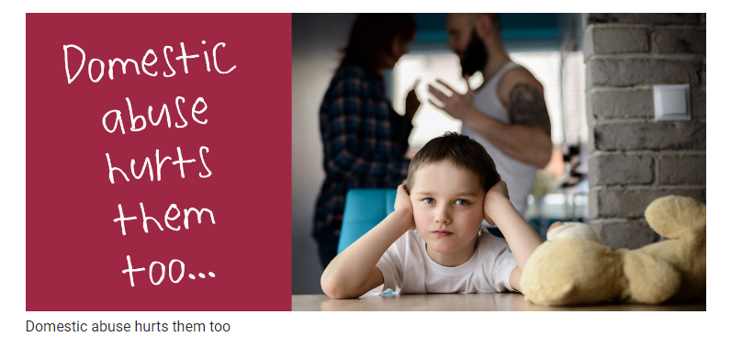
THE IMPACT OF DOMESTIC ABUSE ON CHILDREN
Children will always be affected; the longer the abuse continues the greater the effect.
The definition of Emotional Abuse includes ‘seeing and hearing the ill-treatment of another’ and whilst some children may witness extreme violence, others may live in an atmosphere of detached control. This is just as damaging.
Children can often be more aware of what is going on around them than parents notice or believe.
“It’s ok, my daughter was upstairs listening to her iPad, she didn’t hear anything.’’
“The kids don’t know what’s going on. I manage to hide it well from them. They are fine!”

Slide 17


Slide 18

WHAT IS CHILD SEXUAL EXPLOITATION (CSE)?
It is a form of child sexual abuse and occurs when an individual or group take advantage of an imbalance of power to coerce, manipulate or deceive a child or young person under the age of 18 into sexual activity in exchange for something the victim needs or wants and/or for the financial advantage or increased status of the perpetrator.
Latest statistics show that children are more at risk are:
● younger children (as young as 10 years old)
● Clean skins (young people with no previous record or who are not known to the police)
Clean skins is a common term used by
perpetrators/gangs
Many young people who are groomed are
made to feel special by buying gifts and
giving them lots of attention. Any child or
young people can be affected but there are
some situations that make the victim more
vulnerable to exploitation, for example, if they
are unable to communicate effectively or if
they are isolated from peers/family members.

Slide 19
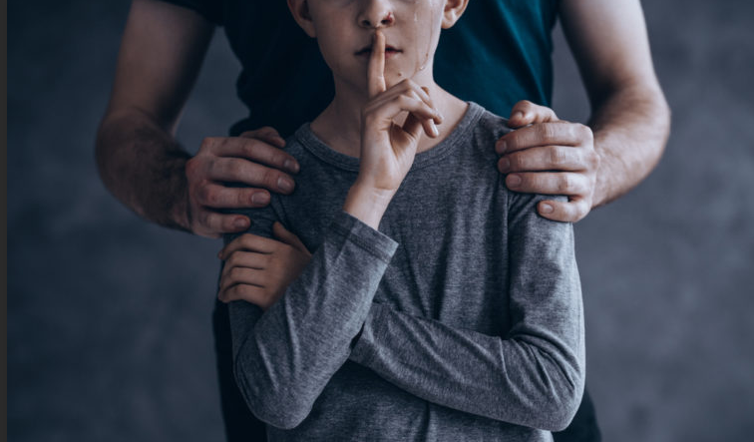

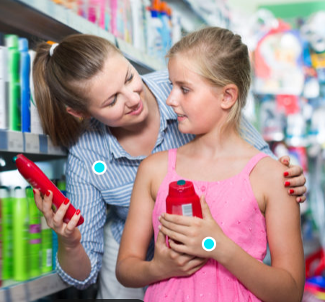
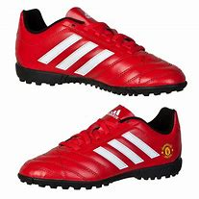

CSE: WHAT PARENTS SHOULD LOOK OUT FOR
Unexplained gifts or new possessions
Older boyfriends/girlfriends
Children displaying sexualised behaviour
Changes in emotional well-being/mood swings
Drugs and alcohol being consumed
Going missing from home or coming home late

Slide 20

CSE
The perpetrator will control and manipulate the victim and try to isolate them from friends and family. Even making threats against family and their victims
The child or young person may think their abuser is their friend or even their boyfriend/girlfriend but the abuser will put them into dangerous situations forcing them to do things they don’t want to do.

Slide 21
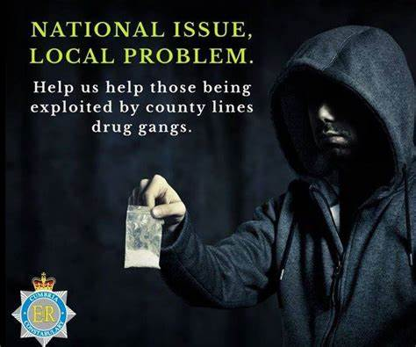


Slide 22
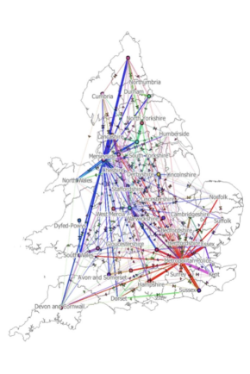
County Lines
County lines is where illegal drugs are transported from
one area to another, often across police and local
boundaries (although not exclusively), usually by children
or vulnerable people who are coerced into it by gangs.
The ‘county line’ is the mobile phone line used to take
order of drugs. Importing areas (areas where the drugs
are taken to) are reporting increased levels of violence
and weapon-related crimes as a result of this trend.
*** Females are as prominent as males being recruited by
gangs.
During the pandemic, TIK TOK was used for celebrating
violent acts and the recruitment of young people and
children into gangs to work within the county lines
culture.

Slide 23
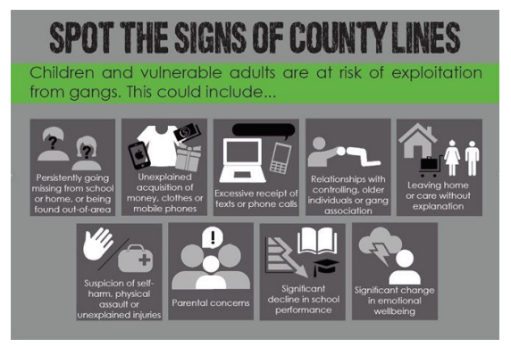
County Lines: Spotting the Signs
Unexplained gifts,
decline in school grades,
multiple mobile phones,
change in mood,
possession of unexplained money,
unexplained injuries,
truancy from school,
going missing from home for periods of time,
carrying weapons,
mentioning gang names,
taking calls and then leaving suddenly

Slide 24


Slide 25
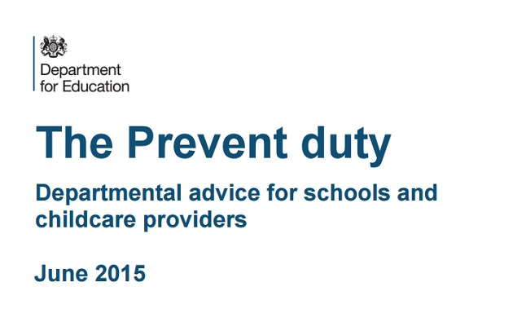
THE PREVENT STRATEGY
The Prevent Strategy is about
safeguarding and supporting those vulnerable to radicalisation.
Radicalisation refers to the process by which a person comes to support terrorism and extremist ideologies associated with terrorist groups.
Extremism is the vocal or active opposition to our fundamental values, including democracy, the rule of law, individual liberty and the mutual respect of tolerance of different faiths and beliefs. This also includes calling for the death of members of the armed forces.

Slide 26
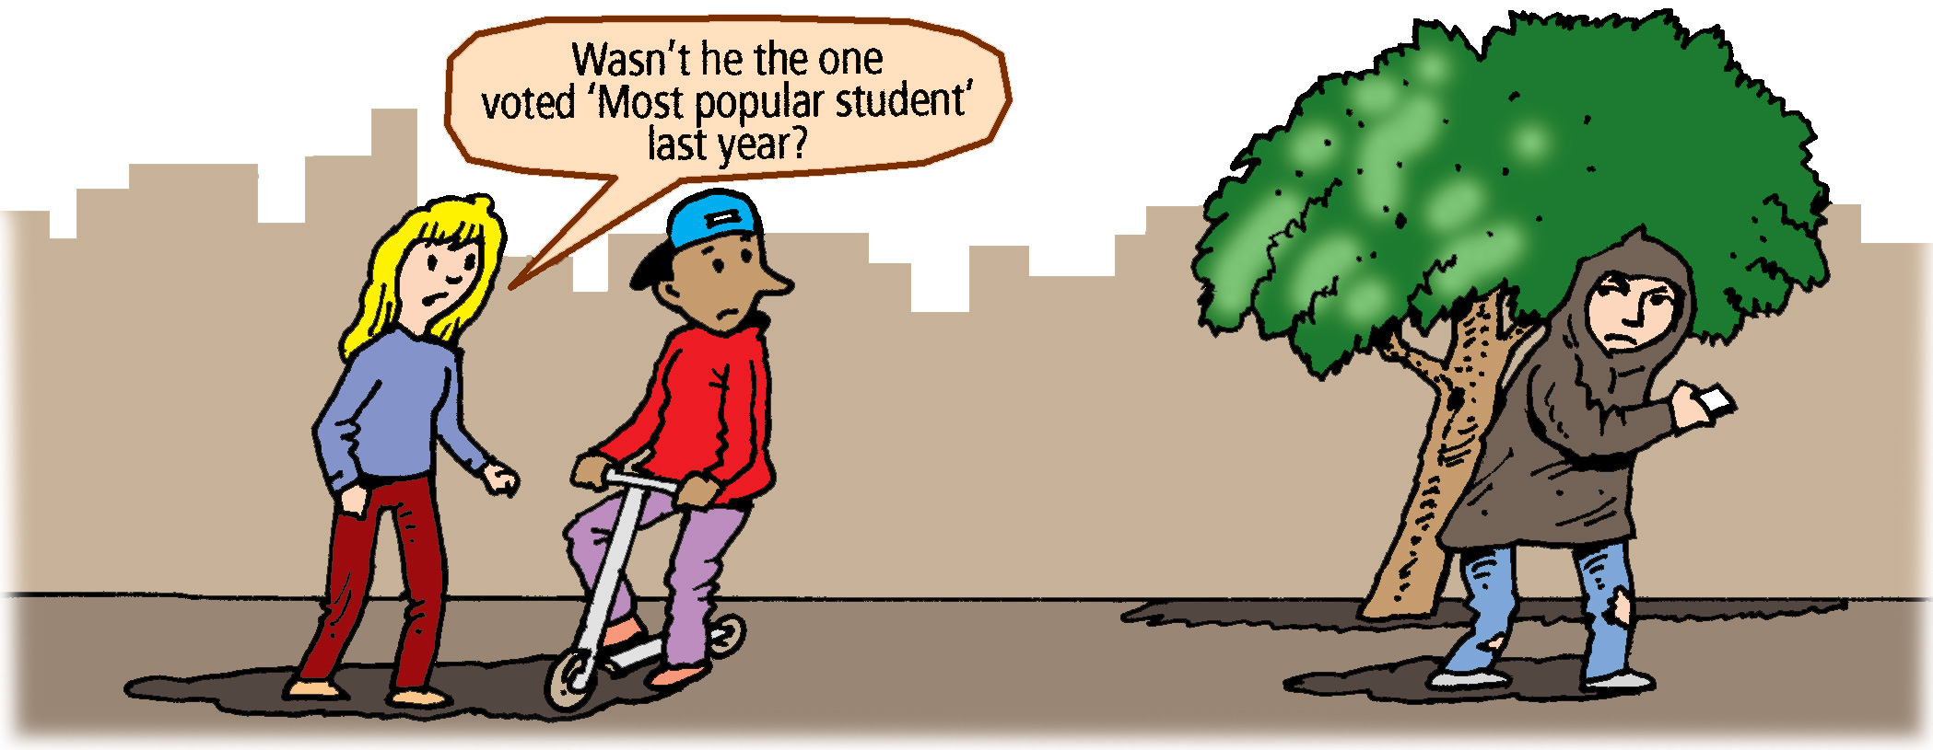
PREVENTING RADICALISATION: THE SIGNS TO LOOK OUT FOR
Isolation from friends/family
Talking as if from a scripted speech
Unwillingness or ability to discuss their views
A sudden disrespectful attitude towards others
Low self esteem
Increased level of anger
Increased secretiveness, especially around internet use

Slide 27
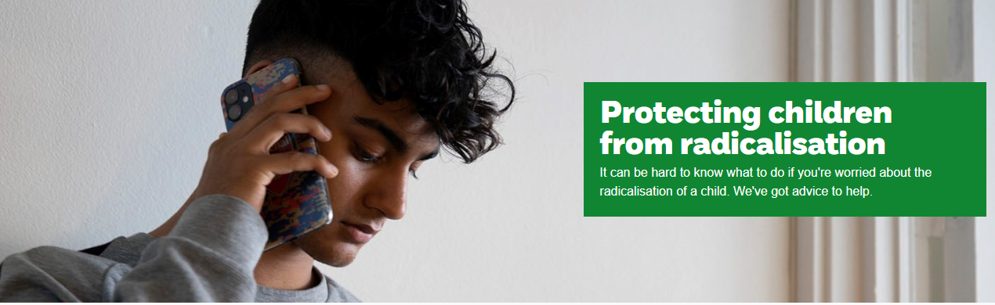
PREVENT: WHAT TO DO IF YOU THINK YOUR CHILD IS BEING RADICALISED.
Contact the NSPCC:
It might be nothing.
It might be something.
There is no harm in talking it through anonymously: 0808 800 5000.
Alternatively, you can contact the NSPCC : help@nspcc.org.uk or complete an online form from their website.
Contact our school Prevent Lead or safeguarding Leads
Call Police anti-terrorism hotline on 0800 789 321

Slide 28
THE IMPACT OF THE PANDEMIC
There has been lots of uncertainty in the world due to the pandemic and children (and some adults) have and are struggling in different ways.
There are ways to help your child if they are showing signs of anxiety or depression:
Talk about feelings and worries and
how ‘normal’ this is
● Keep in touch with family and
friends and balance screen time
● Ensure outside exercise (walks/bike
rides/scootering) is incorporated
into daily routines. This is important
for mental health
● Try to create routines and structure every day
● Help give children a sense of control by allowing them to make decisions and ask questions
● Speak to school. We can help sign post the correct support

Slide 29
Parent Links
Think You Know: https://www.thinkuknow.co.uk/parents/Support-tools/home-activity-worksheets/
Children’s Social Care: Health and Social Care | Cumberland Council
Extremism: https://educateagainsthate.com/
NSPCC Home Page: https://www.nspcc.org.uk/
NSPCC Online Safety: https://www.nspcc.org.uk/keeping-children-safe/online-safety/
Net Aware E-Safety Advice: https://www.net-aware.org.uk/networks/?order=title#
Child Sexual Exploitation: http://www.itsnotokay.co.uk/

Slide 30
Safeguarding Updates 2025
Key updates from KCSIE 2025:
• Online safety expanded to include misinformation, disinformation, conspiracy theories. (NSPCC summary)
• Guidance on generative AI risks added.
• Clarified duties around alternative provision.
• Virtual School Head responsibilities for kinship care clarified.
• New DfE filtering & monitoring self-assessment tool.

