Slide 1

2.PARENTS’ GUIDE TO SAFEGUARDING
2026

Slide 2

ONLINE ABUSE
The NSPCC have defined online abuse as ‘any type of abuse that happens on the internet.’
Any child who uses the internet can be at risk of online abuse. It can happen on any device connected to the web such as computers, tablets, mobile phones and game consoles.
The abuse can be through text messages, emails, online chats, video calls, online gaming and live streaming accounts via social media.
Social media platforms to look out for are:
TIK TOK, House Party, Instagram, Snapchat and WhatsApp

Slide 3

ONLINE ABUSE: WHAT PARENTS NEED TO KNOW
Children can be at risk of online abuse by someone they know or a stranger.
Online abuse could be in addition to other offline abuse such as bullying or grooming.
Sexting and the law: Sending grossly offensive, indecent, obscene or menacing communications is an offence.
By possessing, and/or distributing indecent images of a person under the age of 18 years of age on to someone else is breaking the law under the Sexual offences Act 2003.

Slide 4
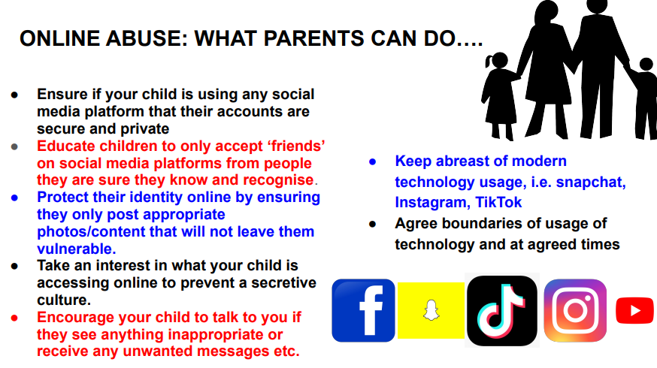

Slide 5
Online Safety Updates 2025
Key 2025 updates:
• Deepfake and AI-generated child abuse material rising sharply.citeturn11search65
• Live-streaming platforms increasingly used for grooming.citeturn11search66
• Children highly vulnerable to deepfakes; 8 million projected in 2025.citeturn11search67
• Online Safety Act 2025 now enforces age verification and bans harmful content for under-18s.citeturn11search59
• Platforms must prevent stranger DMs and harmful recommendations.citeturn11search59

