Slide 1

3.PARENTS’ GUIDE TO SAFEGUARDING
2026

Slide 2


RECOGNISING DOMESTIC ABUSE
Domestic abuse describes any violence or abuse that is used by someone to control or obtain power over their partner. It can include physical, sexual, psychological, verbal, emotional and financial abuse. If you alter your behaviour because you are frightened of how your partner will react, you are being abused.
Freephone 24-Hour National Domestic Abuse Helpline:
0808 2000 247

Slide 3
Controlling & Coercive behaviour
Controlling behaviour :
A range of acts designed to make a person dependant by isolating them from sources of support, depriving them of the means they need for independence and regulating their everyday behaviour.
Freephone 24-Hour National Domestic Abuse Helpline:
0808 2000 247
Coercive behaviour:
An act or a pattern of assault, threats, humiliation and intimidation or other abuse that is used to harm, punish or frighten their victim. This can include rape, ‘honour-based’ violence, Female Genital Mutilation (FGM) and forced marriage.

Slide 4
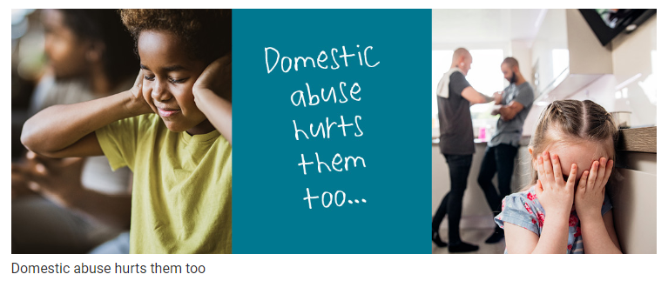
AM I A VICTIM OF DOMESTIC VIOLENCE?
Is your partner excessively jealous?
Is your partner stopping you from seeing your family and friends?
Is your partner telling you what to wear, how to behave and what to say?
Does your partner control your money?
Does your partner monitor your movements?
Does your partner use anger to intimidate you to comply with their commands?
If you have said ‘yes’ to any of these questions, you are in a domestic abuse relationship.
There are many forms of help to support you and your children.
School is one of them.

Slide 5
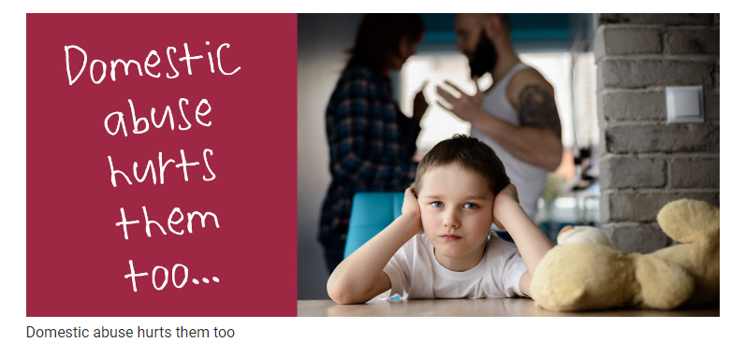
THE IMPACT OF DOMESTIC ABUSE ON CHILDREN
Children will always be affected; the longer the abuse continues the greater the effect.
The definition of Emotional Abuse includes ‘seeing and hearing the ill-treatment of another’ and whilst some children may witness extreme violence, others may live in an atmosphere of detached control. This is just as damaging.
Children can often be more aware of what is going on around them than parents notice or believe.
“It’s ok, my daughter was upstairs listening to her iPad, she didn’t hear anything.’’
“The kids don’t know what’s going on. I manage to hide it well from them. They are fine!”

Slide 6
Parent Links
Think You Know: https://www.thinkuknow.co.uk/parents/Support-tools/home-activity-worksheets/
Children’s Social Care: Health and Social Care | Cumberland Council
Extremism: https://educateagainsthate.com/
NSPCC Home Page: https://www.nspcc.org.uk/
NSPCC Online Safety: https://www.nspcc.org.uk/keeping-children-safe/online-safety/
Net Aware E-Safety Advice: https://www.net-aware.org.uk/networks/?order=title#
Child Sexual Exploitation: http://www.itsnotokay.co.uk/

Slide 7
Domestic Abuse Updates 2025-26
New developments:
• Courts will no longer presume contact with both parents; child safety prioritised (2025 family law reform).citeturn13search89
• Coercive control offenders sentenced 12+ months now managed under MAPPA (2025).citeturn13search90
• Controlling or coercive behaviour legally treated on par with serious violent offending (2025).citeturn13search91
• Children formally recognised as victims of domestic abuse; stronger court protections (2025).citeturn13search92
• New national statistics: 8% of adults experienced domestic abuse last year (ONS 2025).citeturn13search94

