Slide 1
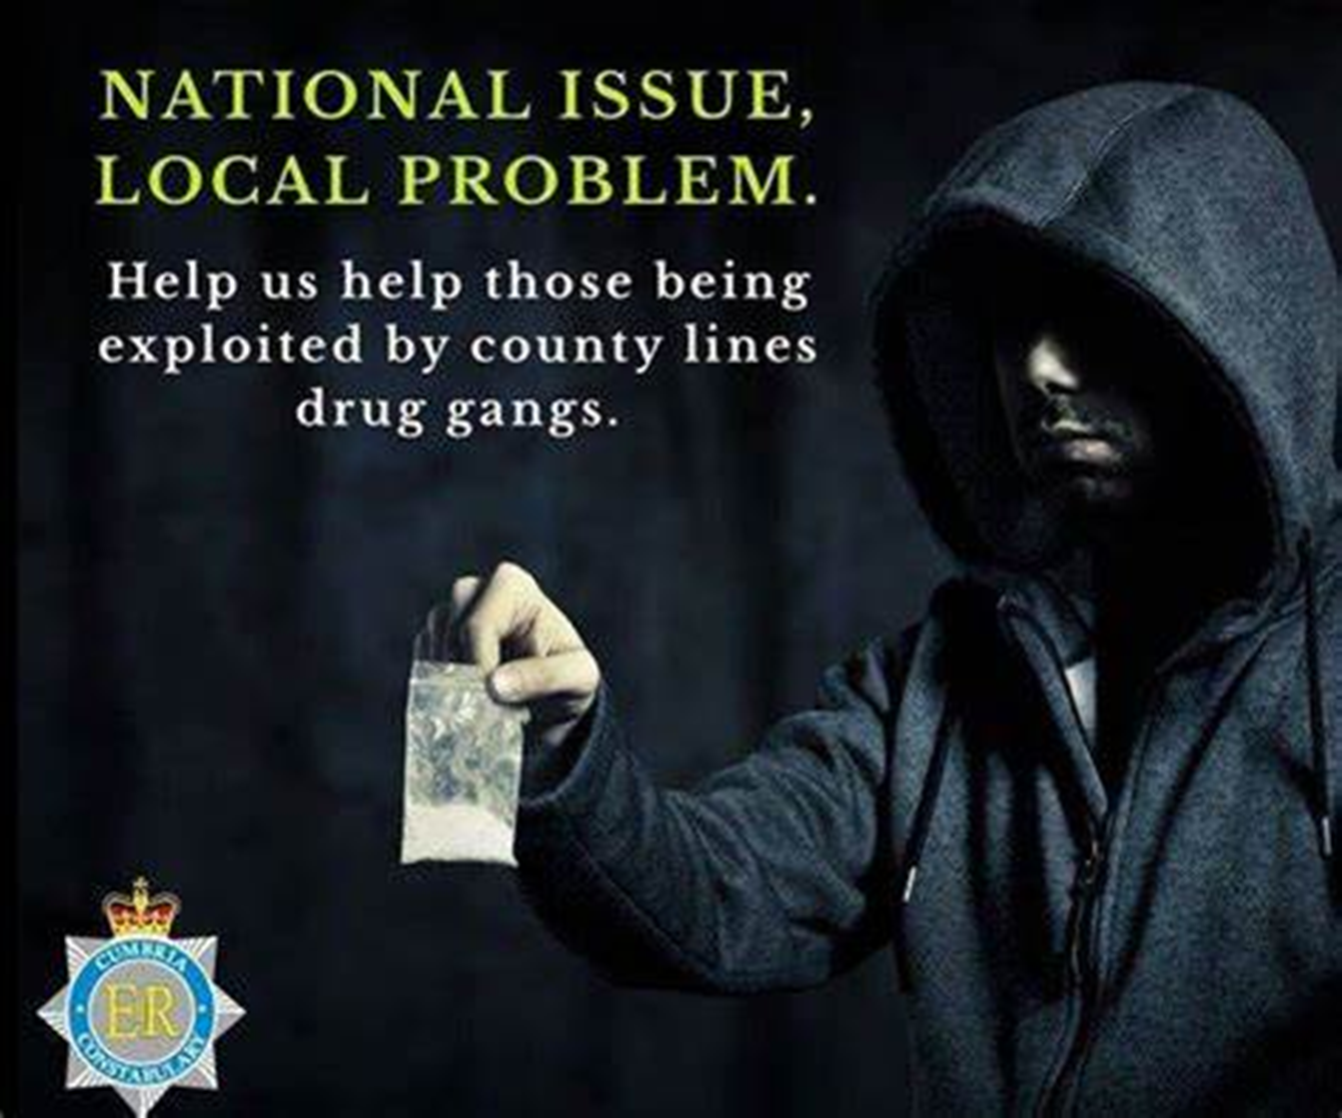
5. PARENTS’ GUIDE TO SAFEGUARDING
2023 - 2024

Slide 2



Slide 3
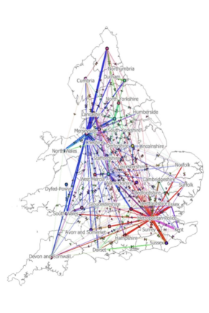
County Lines
County lines is where illegal drugs are transported from
one area to another, often across police and local
boundaries (although not exclusively), usually by children
or vulnerable people who are coerced into it by gangs.
The ‘county line’ is the mobile phone line used to take
order of drugs. Importing areas (areas where the drugs
are taken to) are reporting increased levels of violence
and weapon-related crimes as a result of this trend.
*** Females are as prominent as males being recruited by
gangs.
During the pandemic, TIK TOK was used for celebrating
violent acts and the recruitment of young people and
children into gangs to work within the county lines
culture.

Slide 4
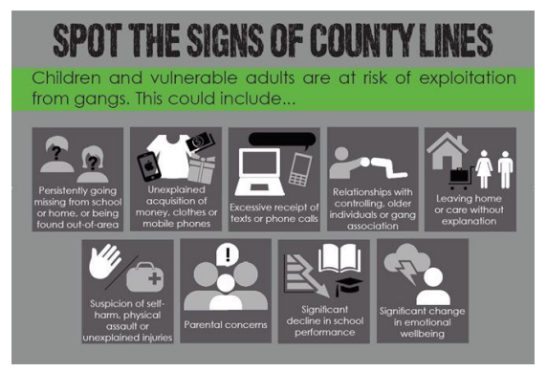
County Lines: Spotting the Signs
Unexplained gifts,
decline in school grades,
multiple mobile phones,
change in mood,
possession of unexplained money,
unexplained injuries,
truancy from school,
going missing from home for periods of time,
carrying weapons,
mentioning gang names,
taking calls and then leaving suddenly

Slide 5
Parent Links
Think You Know: https://www.thinkuknow.co.uk/parents/Support-tools/home-activity-worksheets/
Children’s Social Care: Health and Social Care | Cumberland Council
Extremism: https://educateagainsthate.com/
NSPCC Home Page: https://www.nspcc.org.uk/
NSPCC Online Safety: https://www.nspcc.org.uk/keeping-children-safe/online-safety/
Net Aware E-Safety Advice: https://www.net-aware.org.uk/networks/?order=title#
Child Sexual Exploitation: http://www.itsnotokay.co.uk/

