Slide 1
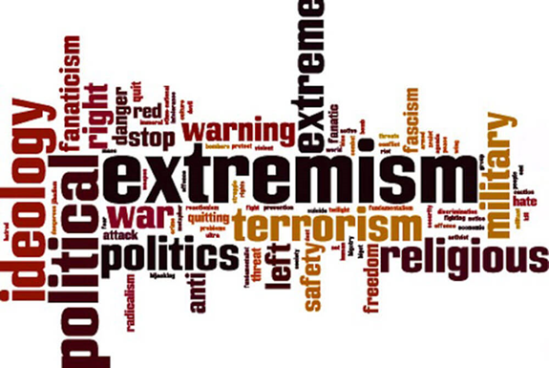
6. PARENTS’ GUIDE TO SAFEGUARDING
2023 - 2024

Slide 2
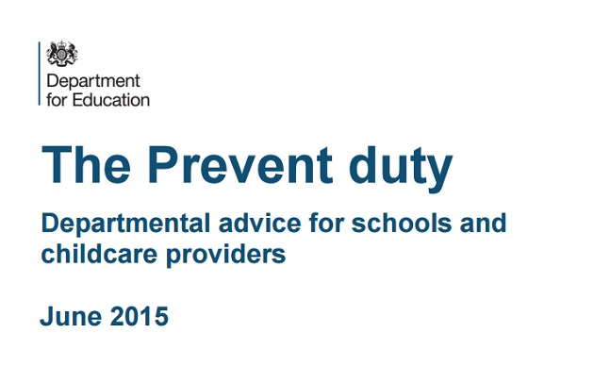
THE PREVENT STRATEGY
The Prevent Strategy is about
safeguarding and supporting those vulnerable to radicalisation.
Radicalisation refers to the process by which a person comes to support terrorism and extremist ideologies associated with terrorist groups.
Extremism is the vocal or active opposition to our fundamental values, including democracy, the rule of law, individual liberty and the mutual respect of tolerance of different faiths and beliefs. This also includes calling for the death of members of the armed forces.

Slide 3
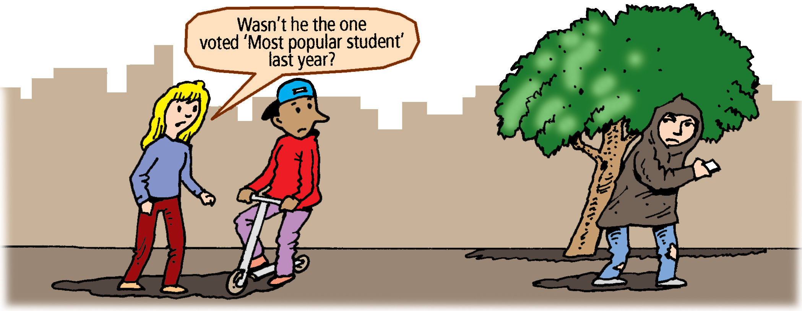
PREVENTING RADICALISATION: THE SIGNS TO LOOK OUT FOR
Isolation from friends/family
Talking as if from a scripted speech
Unwillingness or ability to discuss their views
A sudden disrespectful attitude towards others
Low self esteem
Increased level of anger
Increased secretiveness, especially around internet use

Slide 4
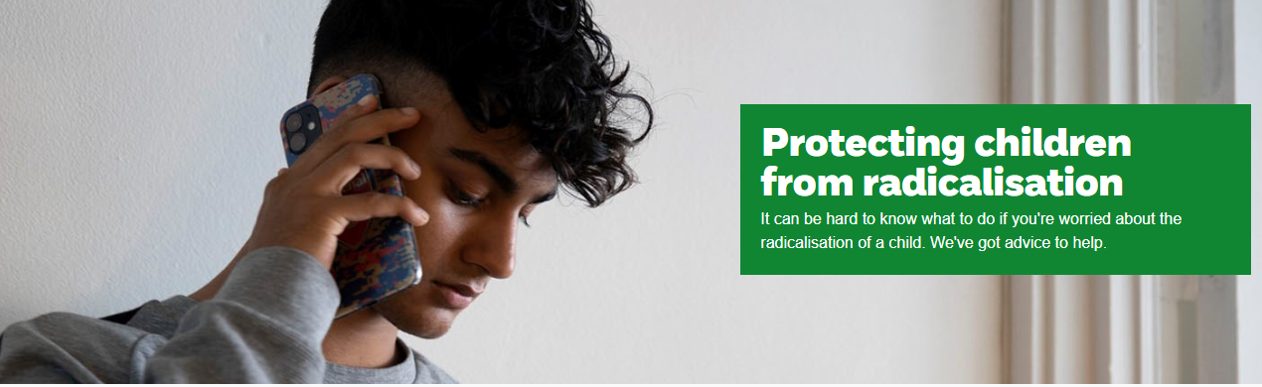
PREVENT: WHAT TO DO IF YOU THINK YOUR CHILD IS BEING RADICALISED.
Contact the NSPCC:
It might be nothing.
It might be something.
There is no harm in talking it through anonymously: 0808 800 5000.
Alternatively, you can contact the NSPCC : help@nspcc.org.uk or complete an online form from their website.
Contact our school Prevent Lead or safeguarding Leads
Call Police anti-terrorism hotline on 0800 789 321

Slide 5
Parent Links
Think You Know: https://www.thinkuknow.co.uk/parents/Support-tools/home-activity-worksheets/
Children’s Social Care: Health and Social Care | Cumberland Council
Extremism: https://educateagainsthate.com/
NSPCC Home Page: https://www.nspcc.org.uk/
NSPCC Online Safety: https://www.nspcc.org.uk/keeping-children-safe/online-safety/
Net Aware E-Safety Advice: https://www.net-aware.org.uk/networks/?order=title#
Child Sexual Exploitation: http://www.itsnotokay.co.uk/

Slide 6
Radicalisation & Online Extremism Updates 2026
Latest developments:
  • UN 2026 warning: AI-driven grooming, deepfakes used to target children.citeturn11search65
  • Surge in AI-generated extremist propaganda and personalised targeting.citeturn11search65
  • Online Safety Act enforcement (2025–26) strengthens duties to stop harmful content from reaching minors.citeturn11search59

