Slide 1

2.PARENTS’ GUIDE TO SAFEGUARDING
2026

Slide 2
What parents need to know!
✅ Artificial Intelligence (AI) can create realistic fake images, videos and voices. ✅ Children may encounter deepfakes, misinformation and AI-generated content online. ✅ Online grooming can occur through social media, gaming platforms and live-streaming services. ✅ Talk regularly with your child about who they communicate with online. ✅ Encourage children to tell a trusted adult if something online makes them feel worried, uncomfortable or unsafe. ✅ Check privacy settings and age restrictions on devices, games and apps. ✅ Remember: online safety is an important part of safeguarding.

Slide 3

ONLINE ABUSE
The NSPCC have defined online abuse as ‘any type of abuse that happens on the internet.’
Any child who uses the internet can be at risk of online abuse. It can happen on any device connected to the web such as computers, tablets, mobile phones and game consoles.
The abuse can be through text messages, emails, online chats, video calls, online gaming and live streaming accounts via social media.
Social media platforms to look out for are:
TIK TOK, House Party, Instagram, Snapchat and WhatsApp

Slide 4

ONLINE ABUSE:
WHAT PARENTS NEED TO KNOW
Children can be at risk of online abuse by someone they know or a stranger.
Online abuse could be in addition to other offline abuse such as bullying or grooming.
Sexting and the law: Sending grossly offensive, indecent, obscene or menacing communications is an offence.
By possessing, and/or distributing indecent images of a person under the age of 18 years of age on to someone else is breaking the law under the Sexual offences Act 2003.

Slide 5
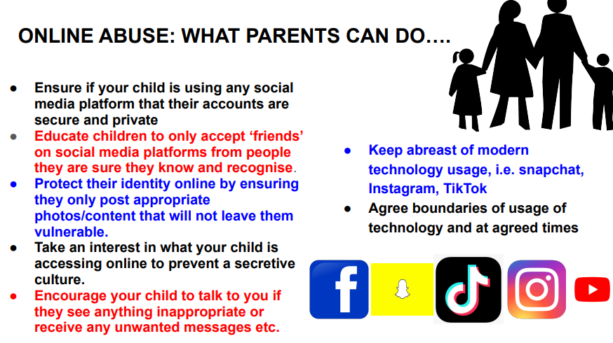

Slide 6
Key 2026 Online Safety Updates
AI-generated images, deep fakes and "nudification" apps are now recognised safeguarding risks. Schools should be alert to AI-created content being used for bullying, harassment, exploitation and image-based abuse. AI-generated intimate images involving children must be treated as a safeguarding concern, even where the image has been digitally created or manipulated. Online grooming continues to evolve, including through live-streaming platforms, gaming environments, social media and AI-enabled communication tools Children should be taught how to identify misinformation, manipulated content and deep fakes, and to question whether online content is genuine Schools are expected to consider AI-related risks within their safeguarding, online safety, filtering and monitoring arrangements. Online safety is everyone's responsibility. Staff, governors, parents and pupils all play a role in protecting children online.

