Slide 1
PARENTS' GUIDE TO WELLBEING, ATTENDANCE & RESILIENCE
Supporting Children to Thrive at Home and School 2026-2027

Slide 2
❤️ Understanding Children's Wellbeing
Children experience many emotions as they grow and develop. ✅ Anxiety ✅ Worry ✅ Frustration ✅ Excitement ✅ Disappointment ✅ Pride
💡 Parent Tip All feelings are normal. Children need support to understand and manage them.

Slide 3
🏠 How Parents Can Help
✅ Listen without judging
✅ Spend quality time together
✅ Maintain routines
✅ Encourage healthy sleep
✅ Balance screen time
✅ Stay connected with school
💡 Parent Tip: Small daily conversations often reveal the biggest worries.

Slide 4
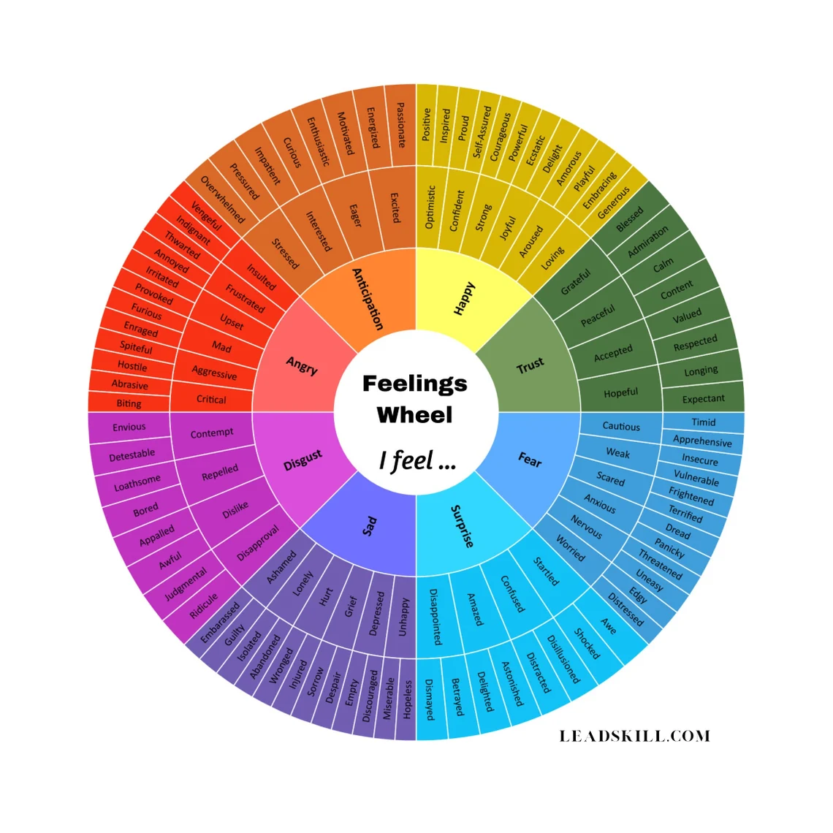
💬 Emotional Wellbeing
💬 Emotional Wellbeing
✅ Ask open questions✅ Validate feelings✅ Stay calm

Slide 5
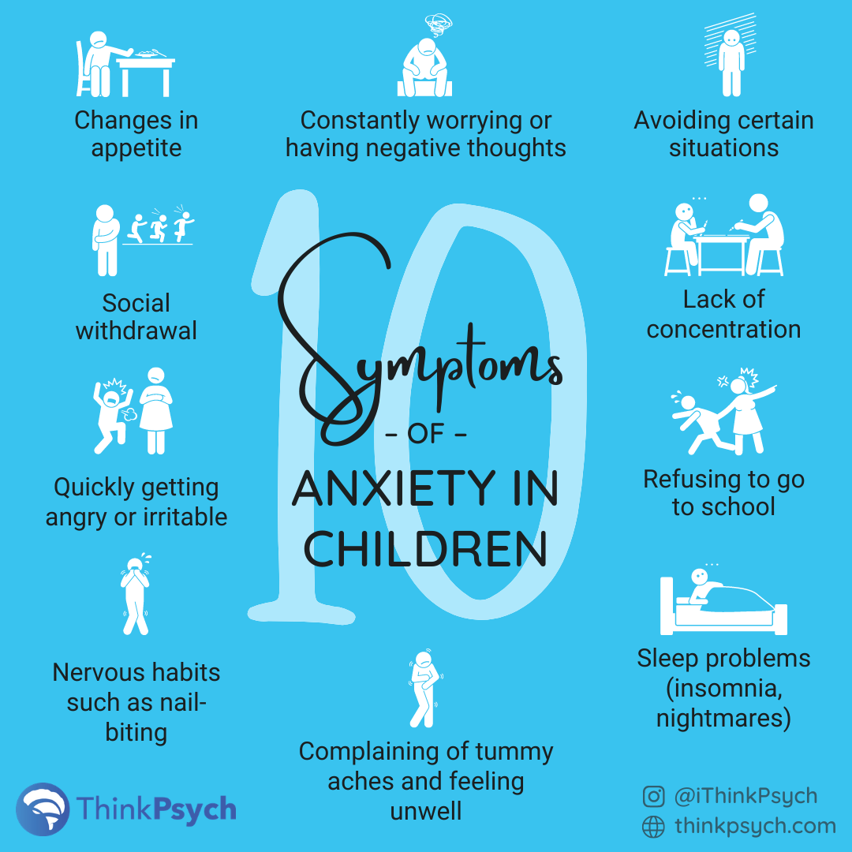
🚩 Recognising Signs of Distress
Possible signs: 🔶 Changes in behaviour 🔶 Sleep difficulties 🔶 Frequent worries 🔶 Social withdrawal 🔶 Low mood 🔶 Emotional outbursts
💡 Speak to school if concerns continue.
https://www.artofit.org/image-gallery/528680443771677314/anxiety-in-children-symptoms-signs-and-how-to-help/

Slide 6
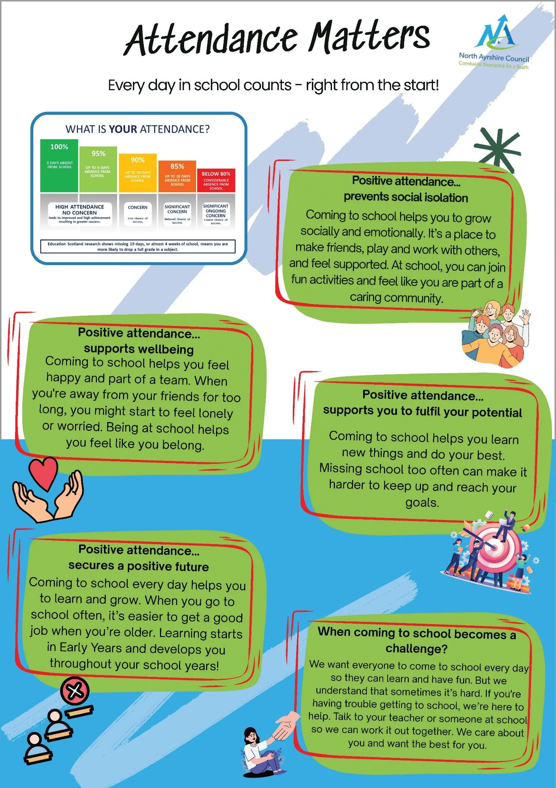
📚 Attendance Matters

Slide 7
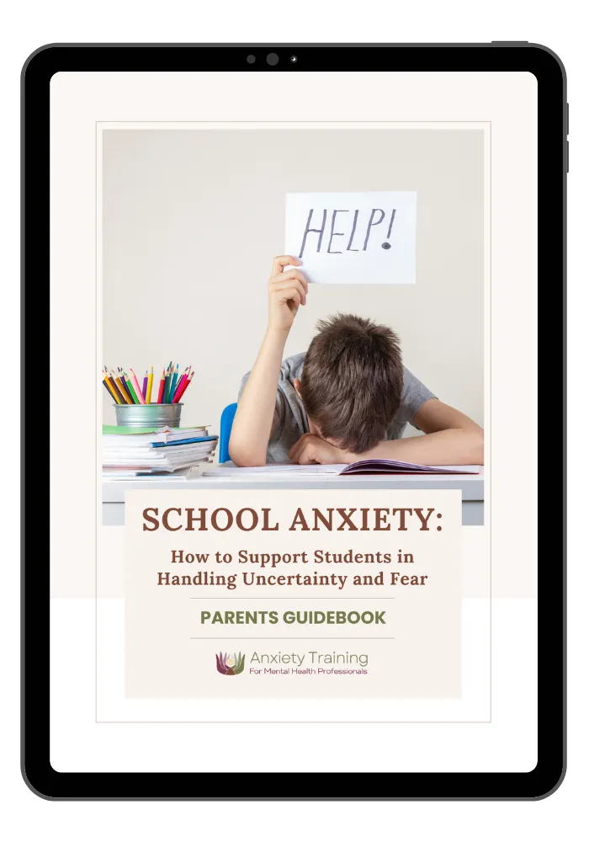
🧠 Understanding School Anxiety
https://anxietytraining.com/guides/school-anxiety-parents/

Slide 8
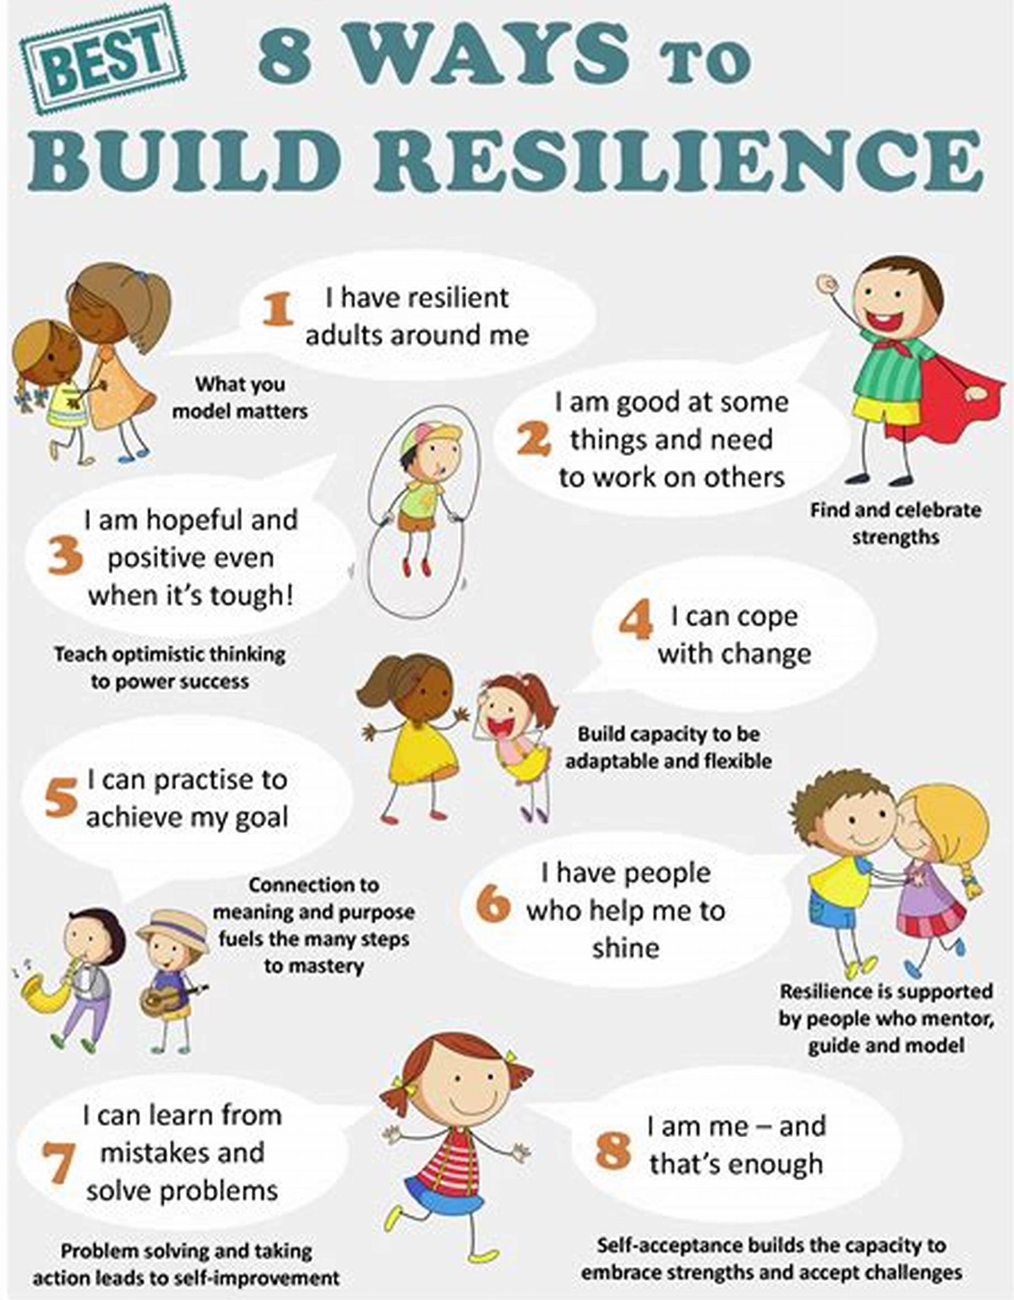
🌱 Building Resilience

Slide 9
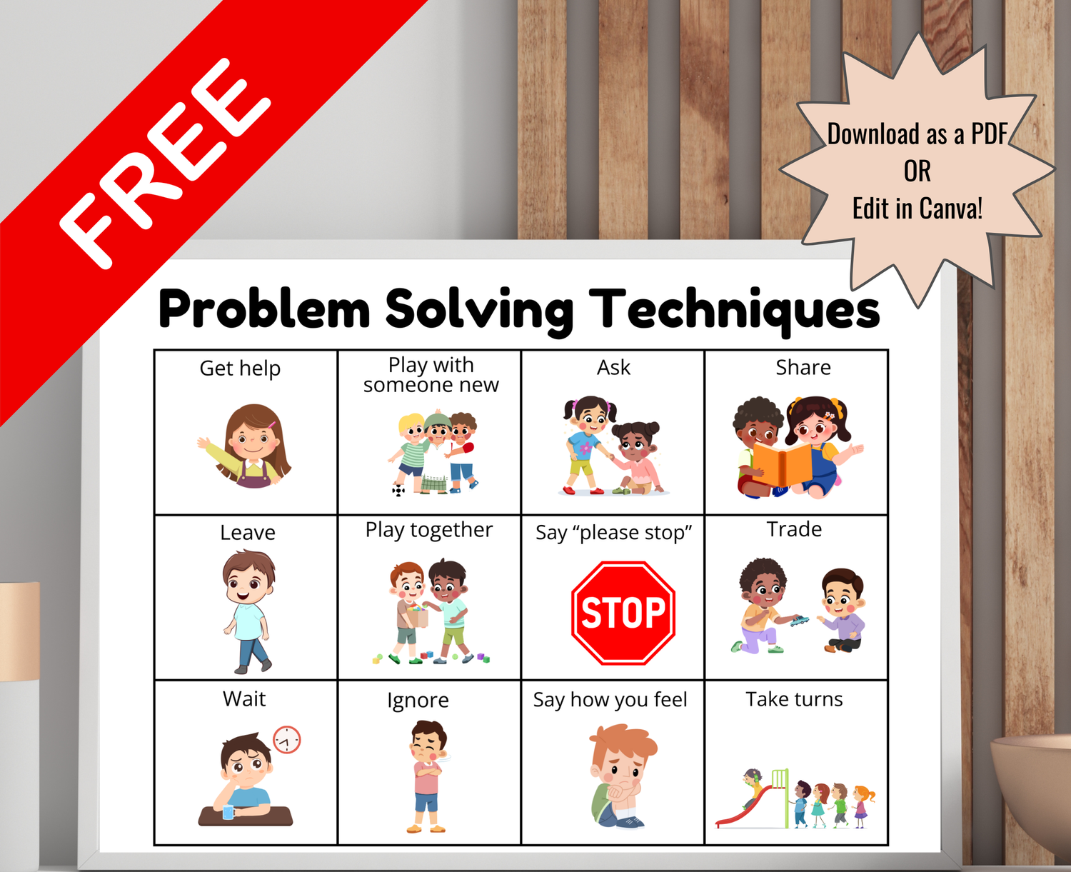
🤝 Encouraging Problem Solving
https://www.stepupconsultingservices.com/step-up-teacher-resources/p/problemsolvingposterforkids
Ask:
💬 What happened?
💬 What could you try?
💬 What support do you need?
💬 What might help next time?

Slide 10
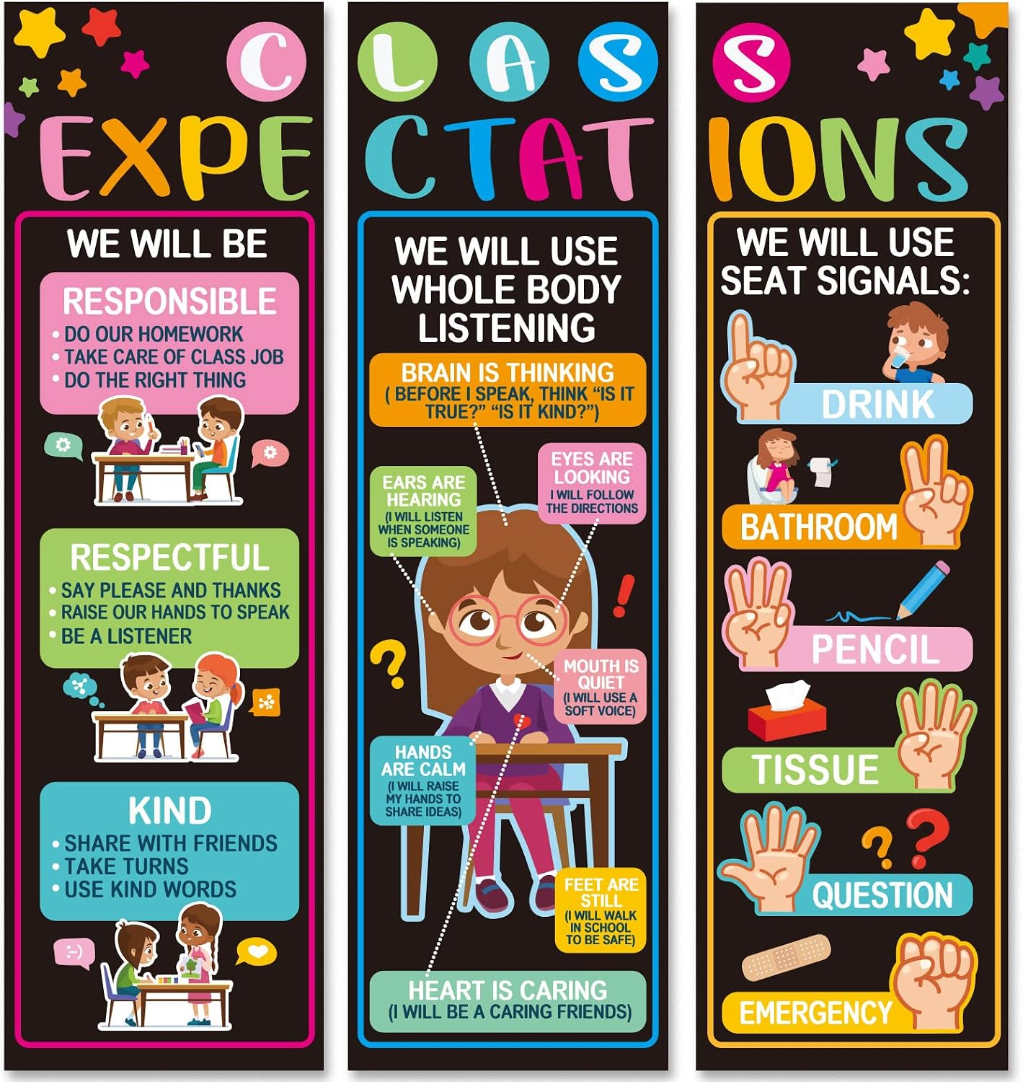
⭐ Supporting Positive Behaviour

Slide 11
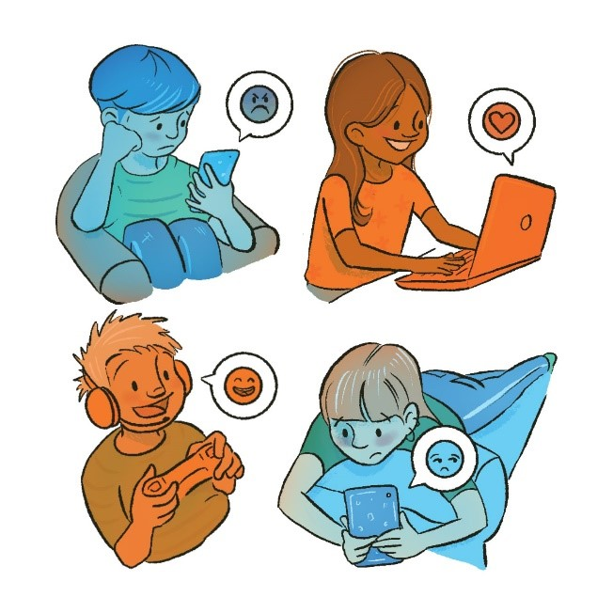
📱 Digital Wellbeing
✅ Balance screen time
✅ Take device breaks
✅ Talk about online experiences
✅ Use privacy settings
✅ Report concerns

Slide 12

🤖
AI & Online Safety
New for 2026
Children may encounter:
✅ Deepfakes
✅ Fake news
✅ AI-generated images
✅ Online scams
✅ Chatbots

Slide 13

❤️ Healthy Relationships
RespectKindnessTrustEmpathySafetyCommunication:

Slide 14
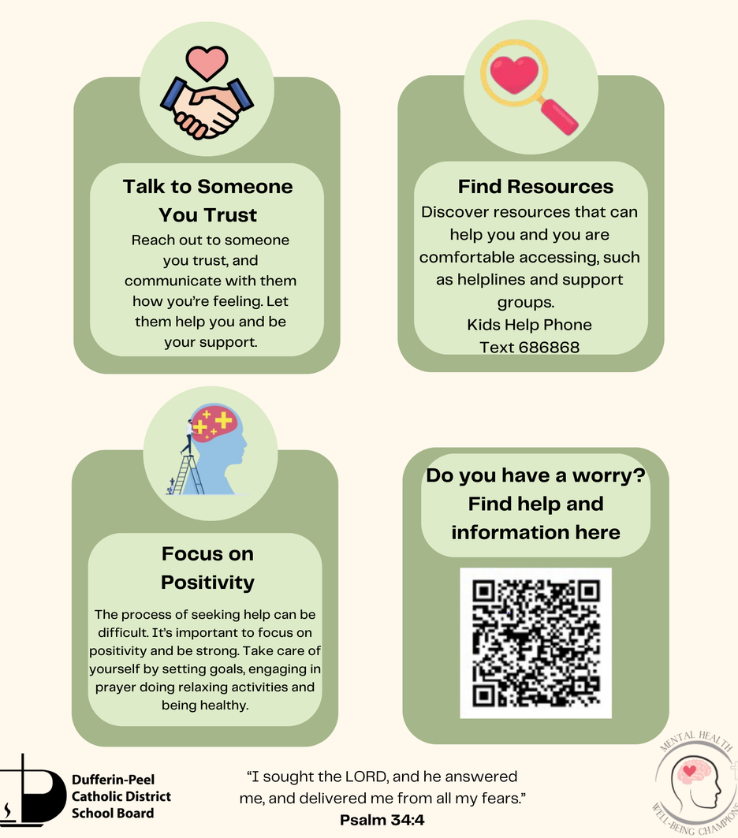
When to Seek Help
Please speak to school if you are concerned about:
Emotional wellbeing
Anxiety
Attendance
Online safety
Friendships
Behaviour
Family circumstances affecting your child
Early support can prevent concerns from becoming bigger difficulties.

Slide 15
Helpful Resources for Parents
Online Safety Thinkuknow NSPCC Online Safety Net Aware Wellbeing & Mental Health YoungMinds Family Lives NHS Mental Health Support Safeguarding Cumberland Children's Services NSPCC Educate Against Hate

Slide 16
Remember... 💙 Every child will face challenges. 💙 Every child needs support. 💙 Resilience grows through relationships. 💙 Small conversations make a big difference. Working together, we can help children feel safe, happy, confident and ready to learn. If in doubt, contact the school's safeguarding team.

